Slide 1
Location Tracking

Slide 2
Methods for tracking
GPS
GSM
RFID
WiFi
Bluetooth Signal Strength

Slide 3
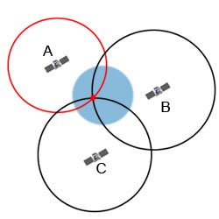
Working of GPS
30 satellites orbiting the Earth sending signals about location coordinate to the receiver
Four satellites visible to the receiver
Satellites are mounted with atomic clocks
Trilateration

Slide 4
Phone tracking with GSM
The technology of locating is based on measuring power levels and antenna patterns and uses the concept that a powered mobile phone always communicates wirelessly with one of the closest base stations, so knowledge of the location of the base station implies the cell phone is nearby.
Multilateration (MLAT) is a navigation technique based on the measurement of the difference in distance to two stations at known locations that broadcast signals at known times.

Slide 5
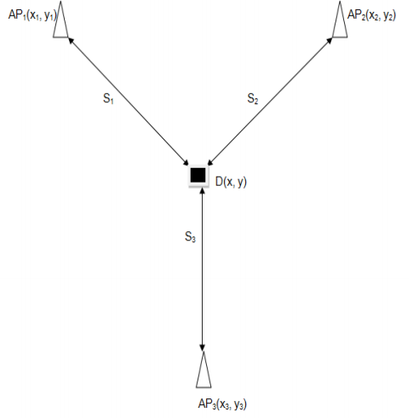
Tracking System Algorithm

Slide 6
Finding Location using CrowdSourcing
Broadcast request.
All the devices receive request
The ones that find the object, replies back.

Slide 7
http://gisgeography.com/trilateration-triangulation-gps/

